Slide 1


Fraud Detection in Banking Transactions
Protecting your assets by identifying and preventing fraudulent activities.

Slide 2

Problem Statement
This project aims to build a real-time fraud detection system in the digital financial landscape, prioritizing low false positive rates and accurate identification of fraudulent transactions. By integrating machine learning, anomaly detection, and rapid monitoring, it addresses the challenge of balancing accuracy and false positives, optimizing models, and refining feature engineering. Its success will foster stakeholder trust, set a technology-driven fraud prevention precedent, and revolutionize fraud detection across sectors.

Slide 3
Types of Fraud in Banking Transactions
Account Takeover Fraud
Identity Theft Fraud
Payment Fraud
Occurs when a fraudster acquires personal information such as a social security number and uses it to open accounts or apply for credit cards, loans, or mortgages.
Occurs when payments are made without proper authorization from the account holder.
Occurs when an unauthorized user gains access to an account owner's financial data and performs transactions on their behalf.

Slide 4
Problem solution used for Fraud Detection in Banking
Data Analytics
Provides a systematic framework to identify, analyze and prevent fraudulent activities by understanding customer behavior.
1
2
3
Machine Learning
UI-Gradio
Uses algorithms to detect unusual patterns or behaviors in transactions to identify fraud quickly.
Gradio interfaces streamline banking transactions by enabling real-time interaction with AI models for fraud detection and investigation.

Slide 5
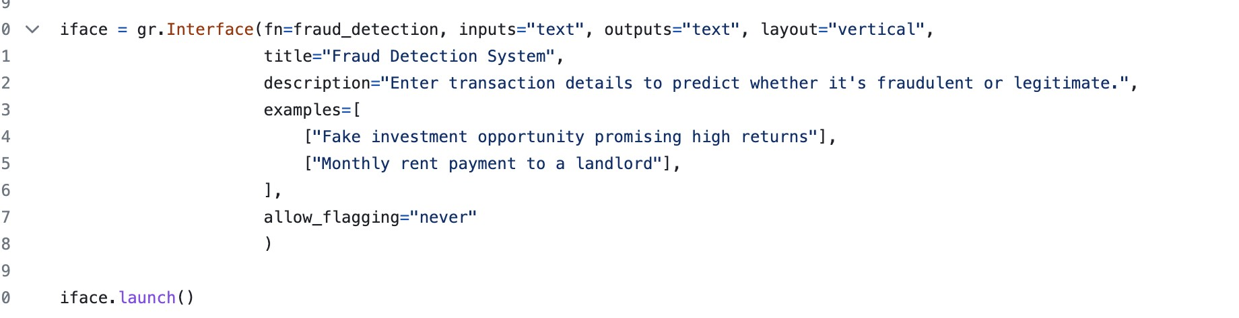
Gradio User Interaction

Slide 6
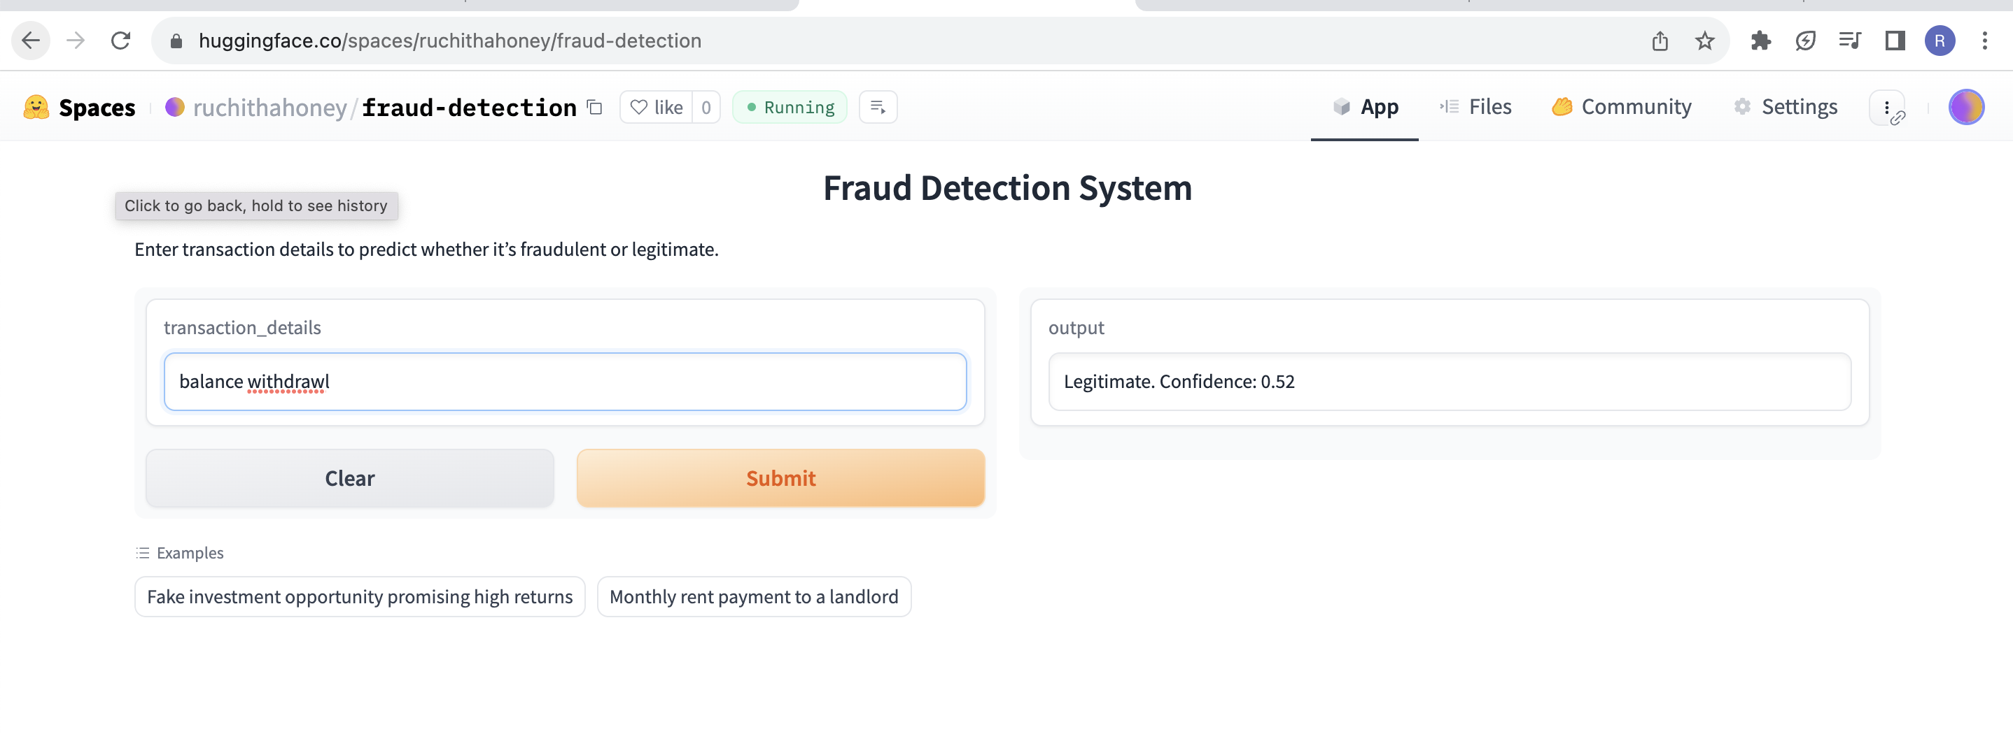
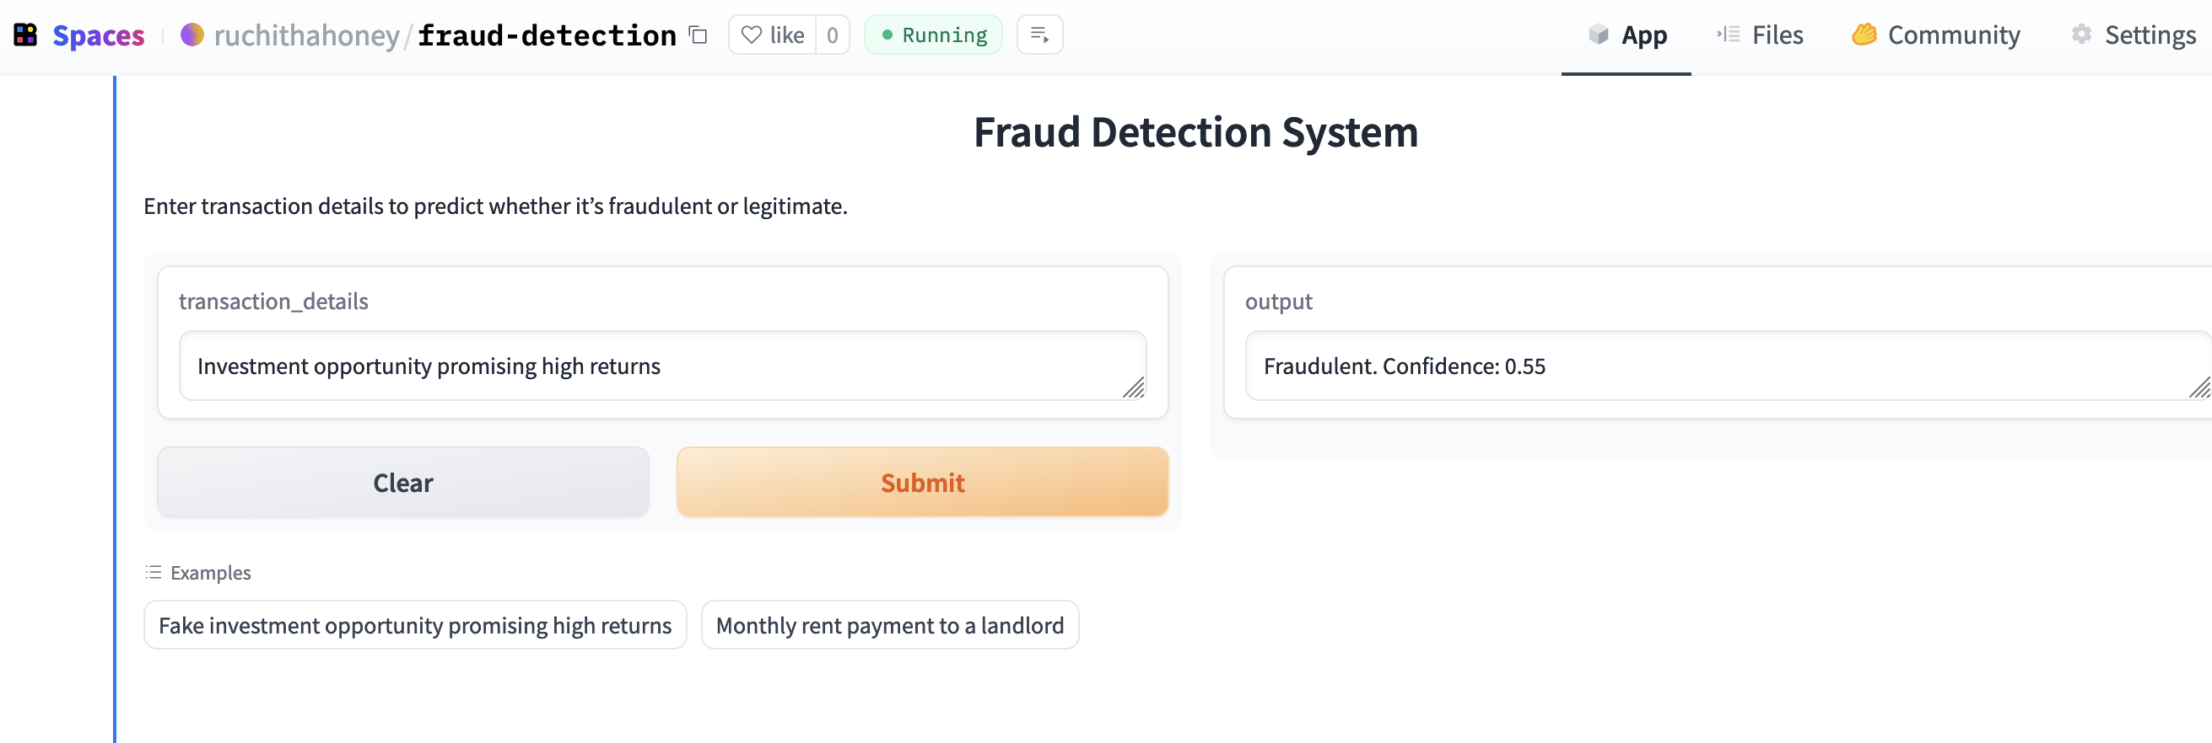
SPACES – Front End
Here we have two screenshot representing the output.
• Integration with Decision Systems:

Slide 7
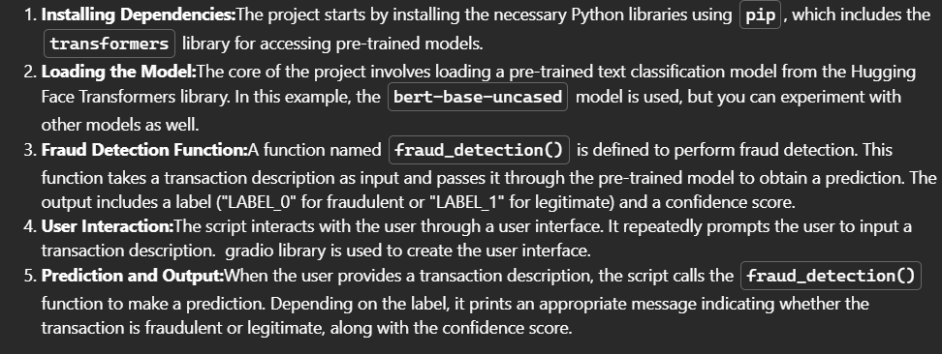
Technical Details

Slide 8
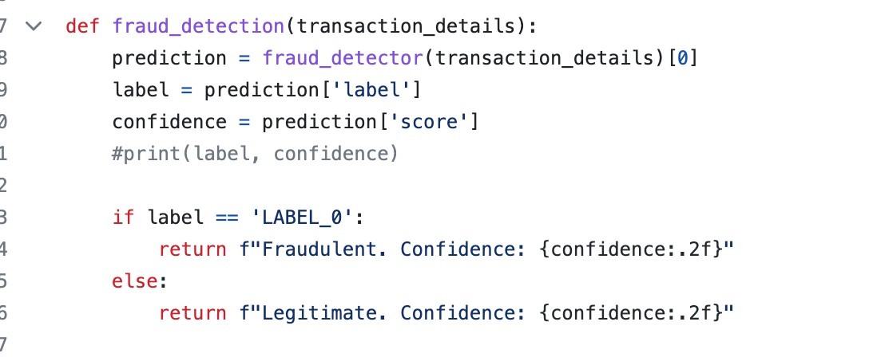
Fraud Detection Function
Bert-Base-Model

Slide 9
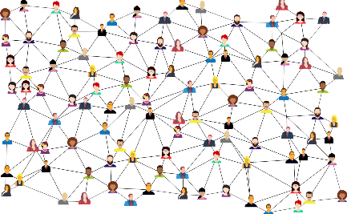

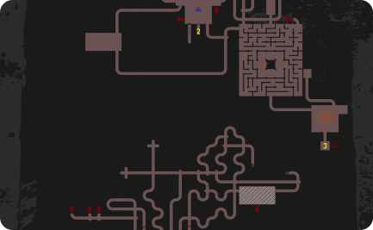
Challenges of Fraud Detection in Banking
High-Volume Transactions
Complexity
Data Overload
As technology advances, so do the methods used by fraudsters, making it challenging to stay ahead of the curve.
Too much data can make it difficult to pinpoint fraudulent activity accurately.
Identifying fraudulent transactions among a large number of legitimate transactions can be difficult.

Slide 10

Conclusion and Key Takeaways
In conclusion, fraud detection requires a combination of human and technological solutions. It is crucial to use the latest technology combined with a strong risk culture to keep ahead of the curve. Remember that prevention is better than cure, so always strive to stay one step ahead of potential threats.

